Slide 1
PROJECT WORK - PHASE 1
(FIRST REVIEW)
Presented by,
Manjusha S 21Z317
Mydhili Nayaki R 21Z324
Shrinidhi S 21Z352
Swetha M 21Z362
Vedavarshini A 21Z368

Slide 2
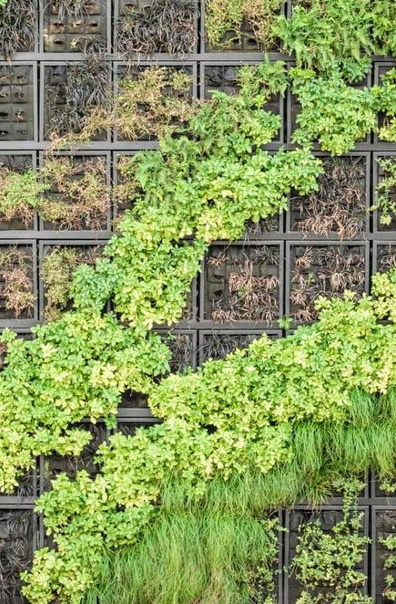
AGENDA
Title
Abstract/Problem Statement
Literature Survey
Software and Hardware Requirements
Tools, Dataset used
Methods used
References
Timeline Chart

Slide 3

SOIL HEAT FLUX DYNAMICS MODELLING USING TEMPORAL DEEP LEARNING FOR DETERMINING PLANT ROOT ZONE TEMPERATURE

Slide 4
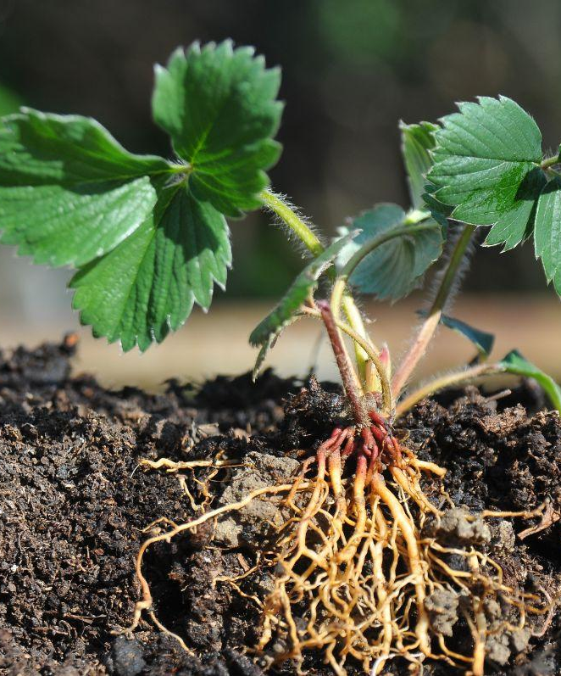
ABSTRACT
Aims to address the critical challenge of accurately predicting soil heat flux dynamics, which directly impact plant root zone temperature and overall agricultural productivity.
Employs Temporal Convolutional Networks (TCNs), a state-of-the-art deep learning architecture designed for temporal sequence data analysis.

Slide 5
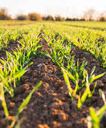
PROBLEM STATEMENT
Productivity of Indian agriculture is often hampered by suboptimal soil temperature regulation, particularly in the root zone of plants.
Inadequate root zone temperature control can lead to poor plant health, reduced crop yields and increased vulnerability to pests and diseases.
Soil heat flux governs the transfer of energy within the soil.
Need for handling sequential data and capturing complex temporal patterns.

Slide 6
OBJECTIVE
By leveraging TCNs, this project aims to develop a robust predictive model that can dynamically forecast soil heat flux and optimize root zone temperature.
This advancement is expected to significantly improve agricultural productivity and sustainability in India, aligning with the nation's goals for food security and economic growth.

Slide 7
HARDWARE AND SOFTWARE REQUIREMENTS
Hardware Requirements
Software Requirements
Component | Specification
CPU | Multi-core processor (e.g., Intel i7, AMD Ryzen 7)
GPU | High-performance GPU (e.g., NVIDIA RTX 3080, Tesla V100)
RAM | At least 16 GB (32 GB or more preferred)
Storage | High-speed SSD (at least 1 TB), additional backup
Networking | Reliable high-speed internet connection
Component | Specification
Operating System | Linux (Ubuntu) or Windows 10/11
Development Environment | Python, Jupyter Notebook, PyCharm, Visual Studio Code or Google Collab
Deep Learning Frameworks | TensorFlow, PyTorch
Libraries | NumPy, pandas, SciPy, scikit-learn, Keras
Visualization Tools | Matplotlib, Seaborn, TensorBoard

Slide 8
TOOLS , DATASET USED
Criteria | Tools to be used | Description
Data Collection & Preprocessing | Pandas & NumPy (Python Libraries) | For cleaning, preprocessing, and handling large sequential datasets efficiently.
Deep Learning Framework | TensorFlow / PyTorch Keras | Implement and train the Temporal Convolutional Networks (TCNs) for modeling soil heat flux dynamics A high-level API built on top of TensorFlow, suitable for designing and tuning the TCN architecture
Temporal Sequence Modeling | Temporal Convolutional Networks (TCNs) | Specialized for handling sequential data. This architecture will be used to capture complex temporal patterns in soil heat flux data.
Optimization | Adam / RMSprop Optimizers, | For tuning the weights of the deep learning model and optimizing the predictive performance of soil heat flux dynamics.
Visualization | Matplotlib / Seaborn | For visualizing the temporal patterns in the data, model performance, and predictions of soil heat flux over time.

Slide 9
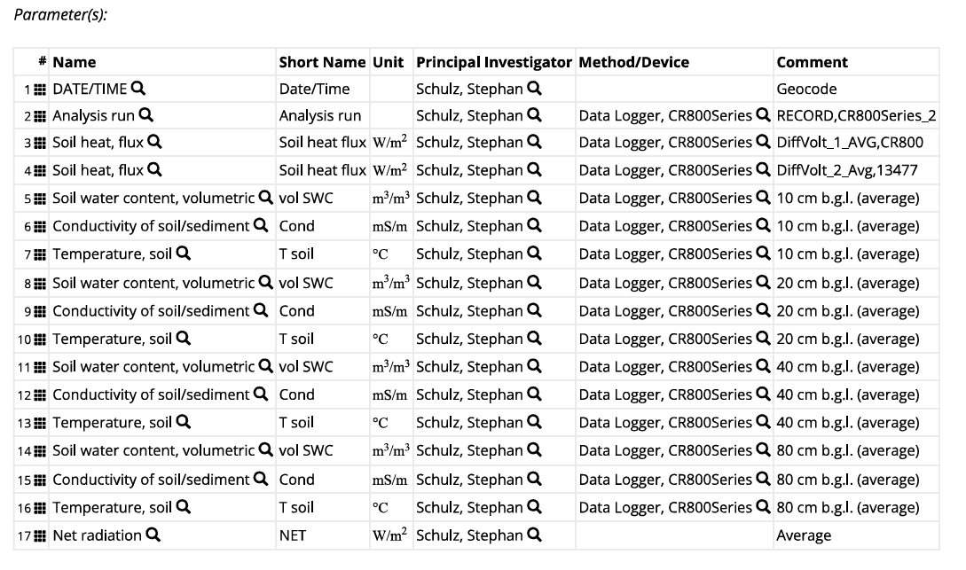
TOOLS , DATASET USED
Dataset Link : https://doi.pangaea.de/10.1594/PANGAEA.921389?format=html#download

Slide 10
METHODS USED

Slide 11
METHODS USED
Temporal Convolutional Networks
1. TCNs use 1D convolutional layers with causal convolutions to ensure that the output at time step t only depends on the inputs from time steps t and earlier, preserving the temporal order.
2. TCNs incorporate dilated convolutions to expand the receptive field of the model exponentially, allowing it to capture long-range dependencies efficiently.
3. These networks use residual connections to facilitate the training of deep networks, preventing the vanishing gradient problem.
4. TCNs can handle variable-length input sequences and are particularly effective in tasks that involve temporal sequences, such as forecasting.
5. By adjusting the dilation factor and the number of layers, TCNs can be tuned to capture both short-term and long-term patterns in the data.

Slide 12
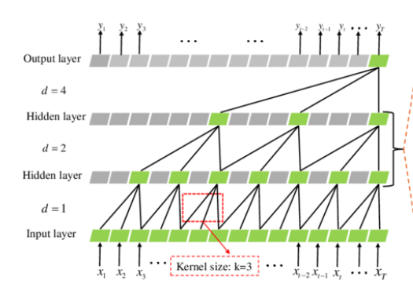
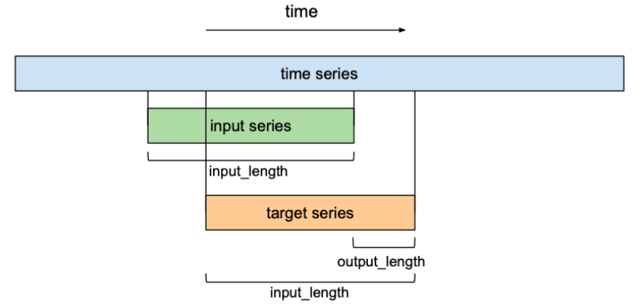
TCN Structure
Forecasting

Slide 13
METHODS USED
Optimization of plant root zone temperature using Bayesian Optimization Technique
Bayesian optimization is a powerful technique for optimizing complex, black-box functions, and it can be effectively used to find soil root zone temperature using soil heat flux data.
Bayesian optimization is used to optimize the prediction of soil root zone temperature by modeling the relationship between soil heat flux and temperature as a complex function.
It uses a surrogate model, typically a Gaussian Process, to approximate this function and iteratively refines predictions by evaluating different input conditions (like soil heat flux) that minimize prediction error.
The process balances exploring new data points and exploiting known patterns to converge on the most accurate root zone temperature estimate.
.

Slide 14
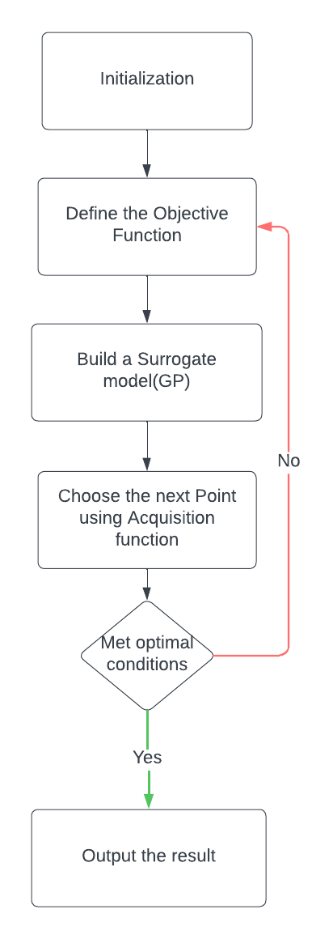
BASIC WORKFLOW OF OPTIMIZATION

Slide 15
IMPLEMENTATION

Slide 16
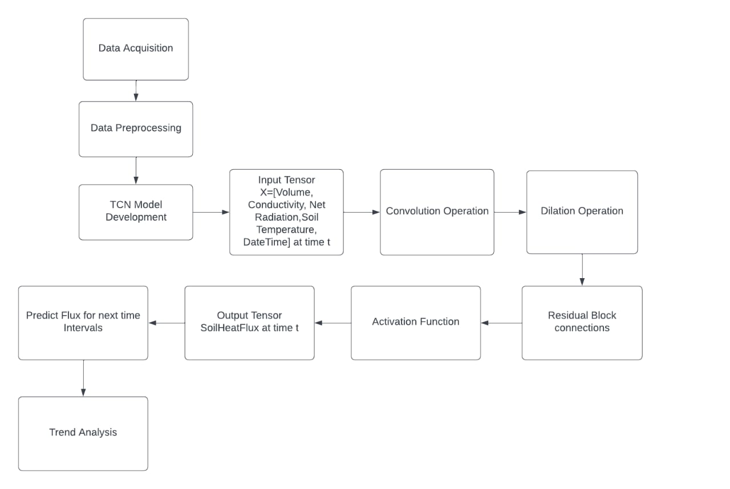
BASIC WORKFLOW

Slide 17
LITERATURE SURVEY

Slide 18
PAPER TITLE | AUTHORS AND PUBLISHER | SUMMARY
Temperature changes in the root ecosystem affect plant functionality https://www.ncbi.nlm.nih.gov/pmc/articles/PMC10203444/ | Mary Paz González-García,1,2,5 Carlos M. Conesa,1,5 Alberto Lozano-Enguita,1 Victoria Baca-González,1 Bárbara Simancas,1 Sara Navarro-Neila,1 María Sánchez-Bermúdez,1 Isai Salas-González,3 Elena Caro,1,2 Gabriel Castrillo,4 and Juan C. del Pozo 1, MDPI | The research paper investigates how temperature changes in root ecosystems affect plants, revealing that high temperatures impact plant development and yield. The study introduces TGRooZ, a device that simulates natural temperature gradients in root zones. Findings show that plants grown with TGRooZ exhibit better root functionality and resilience compared to those under uniform high temperatures, suggesting improved agricultural practices through realistic temperature simulations.
Machine Learning Approach to Simulate Soil CO2 Fluxes under Cropping Systems https://www.mdpi.com/2073-4395/12/1/197 | Toby A. Adjuik and Sarah C. Davis MDPI | The paper evaluates using ML models to predict soil CO2 emissions, leveraging the GRACEnet database. Among the four ML algorithms tested (KNN, SVR, RF, and GB), tree-based models (RF and GB) showed the best performance. This study demonstrates that ML can effectively predict soil CO2 fluxes using readily available field data, offering a cost-effective and efficient alternative to traditional measurement methods.

Slide 19
PAPER TITLE | AUTHORS AND PUBLISHER | SUMMARY
Simultaneous Prediction of Soil Properties Using Multi_CNN Model https://www.mdpi.com/1424-8220/20/21/6271 | Ruixue Li , Bo Yin , Yanping Cong and Zehua Du MPDI | The paper focuses on improving the prediction of soil nutrient content using near-infrared spectroscopy data dual-stream convolutional neural network (Multi_CNN) that integrates one-dimensional and two-dimensional convolutions to predict multiple soil properties simultaneously. This approach addresses the inefficiency and inaccuracy of current soil prediction models. The model is tested on two datasets: a small local dataset from Qingdao, China, and the large-scale LUCAS dataset from Europe.
Daily Dynamics of Soil Heat Flux and Its Relationship with Net Radiation in Different Urban Riparian Woodlands https://www.mdpi.com/1999-4907/13/12/2062 | Anze Liang ,Changkun Xie ,Jing Wang andShengquan Che MPDI | The study focuses on how factors like timing, soil wetness, and vegetation affect this relationship, aiming to improve energy balance models and simulations for riparian zones with different woodlands Aims to enhance energy balance models for different types of woodlands by analyzing data using SPSS with linear and polynomial regression models. the diurnal and seasonal variations of soil heat flux (G) in urban riparian areas and its relationship with net radiation (Rn).

Slide 20
PAPER TITLE | AUTHORS AND PUBLISHER | SUMMARY
Artificial Neural Network Model of Soil Heat Flux over Multiple Land Covers in South America https://www.mdpi.com/2072-4292/13/12/2337 | Bruno César Comini de Andrade, Olavo Correa Pedrollo, Anderson Ruhoff, Adriana Aparecida Moreira MDPI | ANNs predict soil heat flux using remote sensing and meteorological data . Train and validate ANNs with surface temperature, albedo, EVI, and net radiation data from 23 flux towers. ANNs outperformed existing models, reducing mean absolute error by up to 43%. ANNs offer more accurate and generalizable soil heat flux predictions across diverse land covers and climates in South America.
A Numerical Model to Estimate the Soil Thermal Conductivity Using Field Experimental Data https://www.mdpi.com/2076-3417/9/22/4799 | Leugim Corteze Romio, Débora Regina Roberti, Lidiane Buligon, Tamires Zimmer, and Gervásio Annes Degrazia. MDPI | Developed a numerical model using Fourier's Law with an empirical parameter to estimate soil thermal conductivity using soil heat flux.. Least Squares Method (LSM) was used to fit a linear relationship between soil heat flux and temperature gradient. The model with the empirical parameter (ε) provided more accurate soil thermal conductivity estimates. Validated with field data from Brazil's Pampa biome, the model improves soil thermal conductivity estimation across varying moisture conditions.

Slide 21
PAPER TITLE | AUTHORS AND PUBLISHER | SUMMARY
Spatial–temporal modeling of root zone soil moisture dynamics in a vineyard using machine learning and remote sensing. https://link.springer.com/article/10.1007/s00271-022-00775-1 | Kisekka, I., Peddinti, S.R., Kustas, W.P. et al. Springer nature | Semi-empirical models, pySEBAL and EFSOIL, with a data-driven Random Forest (RF) model for RZSM prediction. The RF model was trained using in situ soil moisture data from TDR sensors in a vineyard ML models, especially RF, are effective for RZSM prediction with proper training data. Combining remote sensing with ML enhances precision in agricultural water management.
Root-zone soil moisture estimation based on remote sensing data and deep learning https://www.sciencedirect.com/science/article/pii/S0013935122006053 | Kartal S, Iban MC, Sekertekin A. Elsevier | Convolutional Long Short-Term Memory (ConvLSTM) model, which effectively captures spatiotemporal patterns and handles complex nonlinear relationships. Hydrus-1D was used to create a comprehensive vertical soil moisture dataset for model training and validation Remote sensing-based factors, like NDVI, were selected for their correlation with soil moisture at various depths. Combining AI with physical models provides a powerful and accurate tool for predicting root-zone soil moisture on a large scale

Slide 22
PAPER TITLE | AUTHORS AND PUBLISHER | SUMMARY
Ensemble machine learning for interpretable soil heat flux estimation https://doi.org/10.1016/j.ecoinf.2024.102697 | James F. Cross and Darren T. Drewry Elsevier | Thorough survey of various statistical and deep learning models such as SES, Holt Winters, ARIMA and Prophet and CNN, RNN and LSTM is presented, focusing on their application in forecasting. Discusses multiple error metrics for model validation, providing insights into improving forecast reliability such as MAE, RMSE and MAPE.
Time Series Prediction Based on Temporal Convolutional Network 10.1109/ICIS46139.2019.8940265 | Yujie Liu, Hongbin Dong, Xingmei Wang, Shuang Han IEEE | Introduces gated linear units to enhance gradient propagation and proposes a multi-channel gated temporal convolution network model. Model is applied to various prediction tasks, including stock prices, Mackey-Glass time series, PM2.5 levels and energy consumption. Experimental results demonstrate that TCNs converge faster and perform better compared to traditional methods and models such as LSTM and GRU.
Machine Learning Algorithms for Time Series Analysis and Forecasting 10.48550/arXiv.2211.14387 | Rameshwar Garg, Shriya Barpanda, Girish Rao Salanke N S, Ramya Shivamadegowda Cornell Archives | Developed and evaluated ensemble machine learning (ML) models to predict soil heat flux (SHF) with high temporal resolution (half-hourly) throughout the growing season, surpassing traditional semi-empirical models Highlights the importance of careful predictor selection. SHAP were employed to improve model interpretability, showing that models with fewer input variables were more linear and interpretable, suggesting simplicity in model design.

Slide 23
REFERENCES
https://github.com/bayesian-optimization/BayesianOptimization
https://unit8.com/resources/temporal-convolutional-networks-and-forecasting/
https://doi.pangaea.de/10.1594/PANGAEA.921389?format=html#download
https://ieeexplore.ieee.org/document/9781897
https://link.springer.com/article/10.1007/s40808-015-0041-2
https://www.ncbi.nlm.nih.gov/pmc/articles/PMC11244811/
https://www.mdpi.com/2073-4395/11/8/1521
https://www.sciencedirect.com/science/article/abs/pii/S0034425721001528

Slide 24
TIMELINE CHART
1
2
3
4
June-July
August
September
October
Identifying the area of interest
Finalizing the problem statement
Literature survey on the chosen domain.
Selecting the suitable Deep Learning model and optimization algorithm
Understanding the underlying architecture of the model.
Dataset Collection
Data Understanding and preprocessing
Model Development (TCN)
Fine tuning the developed model.
Optimization of root zone temperature
Model Deployment
Preparation and Publication of research paper

Slide 25
Thank you!

